Slide 1
GITHUB PROFILE VIEWER
Presented by
DIVYA BHORIA 2210990293
GEETANSH SOOD 2210990323
OJAS GUPTA 2210990627
Under the supervision of
MS PARUL GAHELOT
MR VIKAS PATEL
Department of Computer Science and Engineering
Chitkara University Institute of Engineering & Technology,
Chitkara University, Punjab

Slide 2
Introduction
Problem Statement:- The standard GitHub profile page lacks personalization, hindering developers from effectively showcasing their skills. To overcome this, a dedicated GitHub profile viewer website is needed, providing a customizable platform for enhanced self-promotion and collaboration. How can we create a solution that allows developers to make a lasting impression in the competitive software development landscape?
Solution - We aim to overcome the limitations of the standard GitHub profile, providing developers with a tool to showcase their skills effectively in the competitive software development landscape by allowing them to
Personalized Profiles:
Develop a dedicated GitHub profile viewer website using HTML, CSS, JavaScript, and Tailwind CSS.
Allow developers to customize their profiles for a unique and visually appealing representation.
Dynamic Showcase:
Enable dynamic display of skills, projects, and achievements to create an engaging project portfolio.
Responsive Design:
Utilize HTML, CSS, JavaScript, and Tailwind CSS for a responsive and seamless user experience.
Effective Self-Promotion:
Empower developers to emphasize their strengths, coding style, and personality for better self-promotion.
Lasting Impression:
Create a visually striking platform to help developers stand out and leave a lasting impression.
Collaboration Hub:
Facilitate collaboration by centralizing profiles, making it easier for developers to connect.

Slide 3
Motivation of Research
The motivation behind creating this API stems from the recognition of a growing need for developers to have a more personalized and dynamic platform to showcase their skills and projects. The standard GitHub profile page offers limited customization options, hindering developers from presenting a comprehensive and visually appealing representation of their coding journey. By developing this API, we aim to empower developers with a dedicated GitHub profile viewer website that leverages technologies like HTML, CSS, JavaScript, and Tailwind CSS. The goal is to provide a customizable space where developers can not only display their skills and contributions dynamically but also tailor the design to reflect their unique coding style. This initiative is driven by a desire to enhance self-promotion, collaboration, and overall visibility within the competitive landscape of software development, enabling developers to make a lasting and impactful impression on potential collaborators, employers, and the broader coding community.

Slide 4
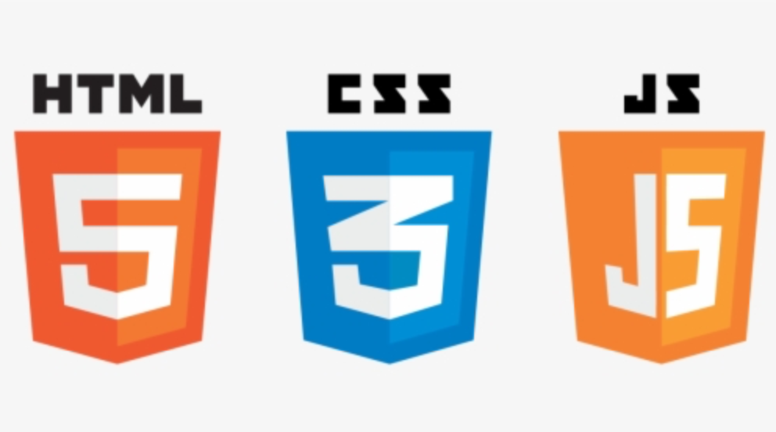

Tools & Technologies
1 . HTML (Hypertext Markup Language)
- Foundation of web development for structuring content on a webpage.
- Utilizes tags to define elements such as headings, paragraphs, images, and links.
- Provides the basic structure for creating web pages and is essential for building the user interface.
2. CSS (Cascading Style Sheets)
- Stylesheet language used for describing the presentation of a document written in HTML.
- Enables the separation of content and presentation, allowing for consistent styling across multiple pages.
- Includes selectors, properties, and values to define the visual appearance, layout, and design of HTML elements.
3. JavaScript
- Versatile scripting language primarily used for enhancing interactivity and dynamic behavior on web pages.
- Allows for client-side scripting, enabling the creation of responsive and interactive user interfaces.
- Supports event-driven programming and can manipulate the Document Object Model (DOM) for real-time updates.
4. Tailwind CSS
- Utility-first CSS framework designed to streamline the styling process.
- Utilizes pre-defined utility classes for common styles, reducing the need for custom CSS.
- Offers a modular and highly customizable approach to styling, facilitating rapid development and consistent design patterns.

Slide 5
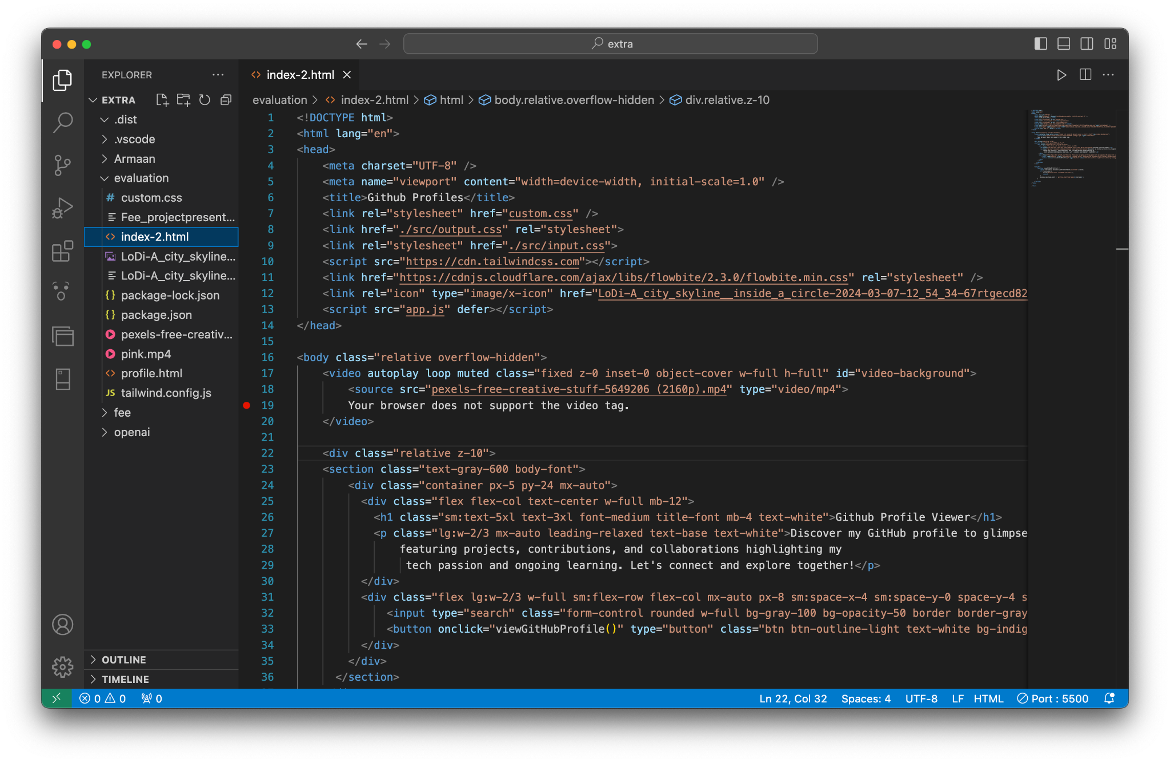
Code Snapshots

Slide 6
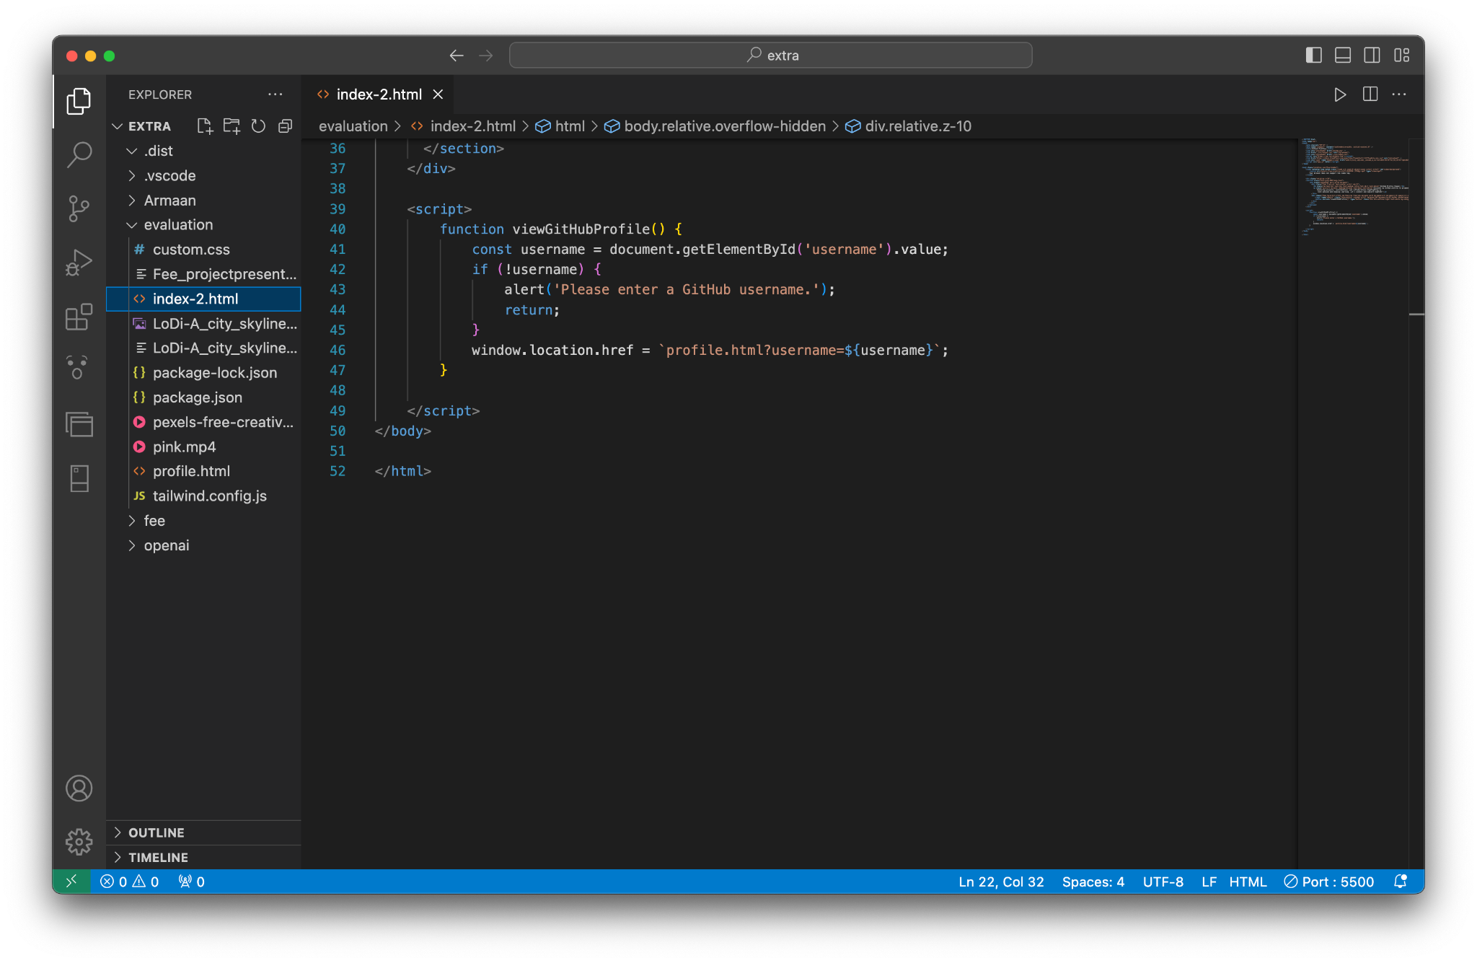
Code Snapshots

Slide 7
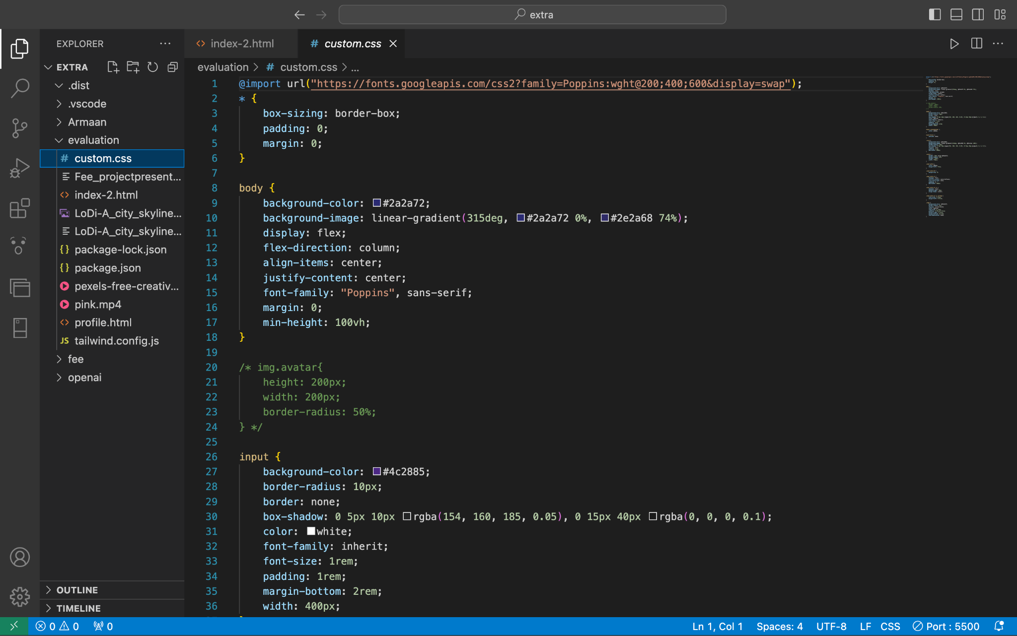
Code Snapshots

Slide 8
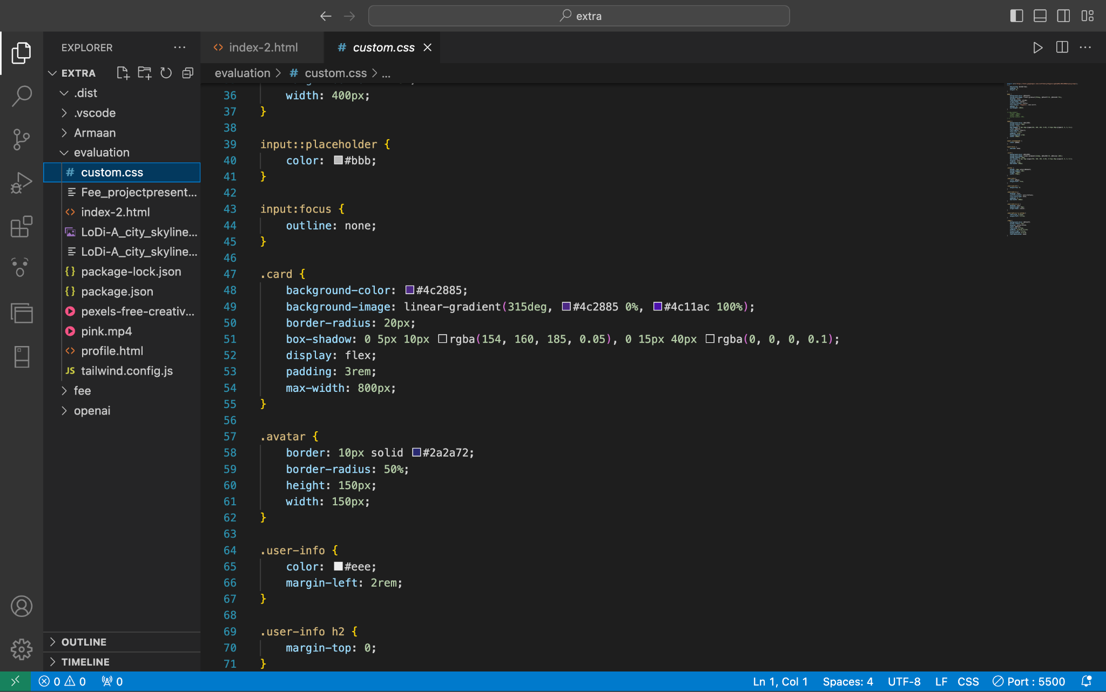
Code Snapshot

Slide 9
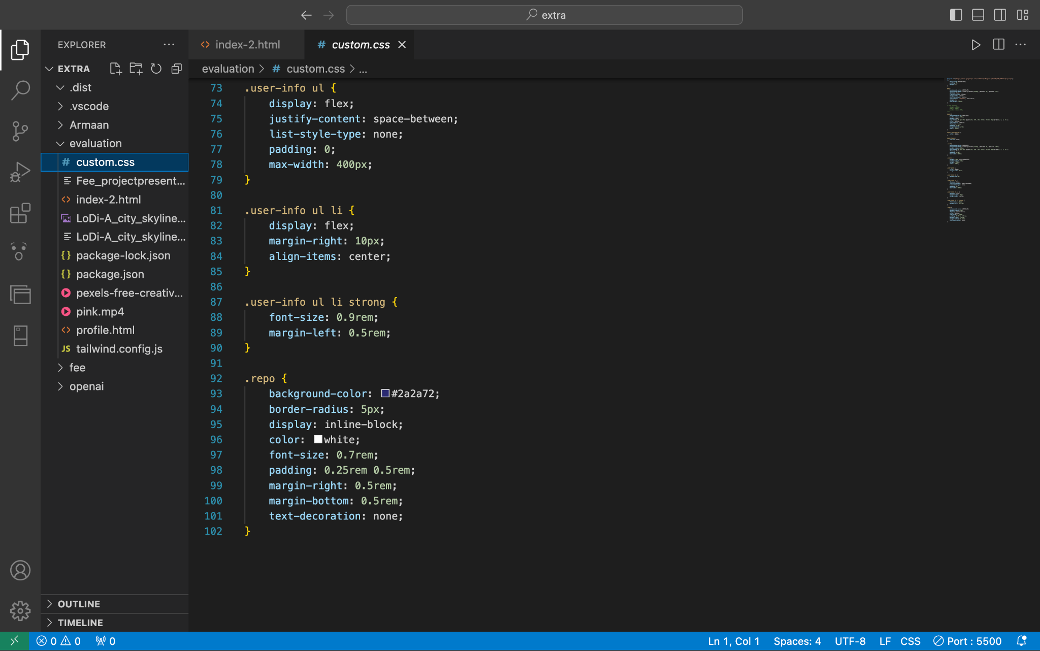
Code Snapshots

Slide 10
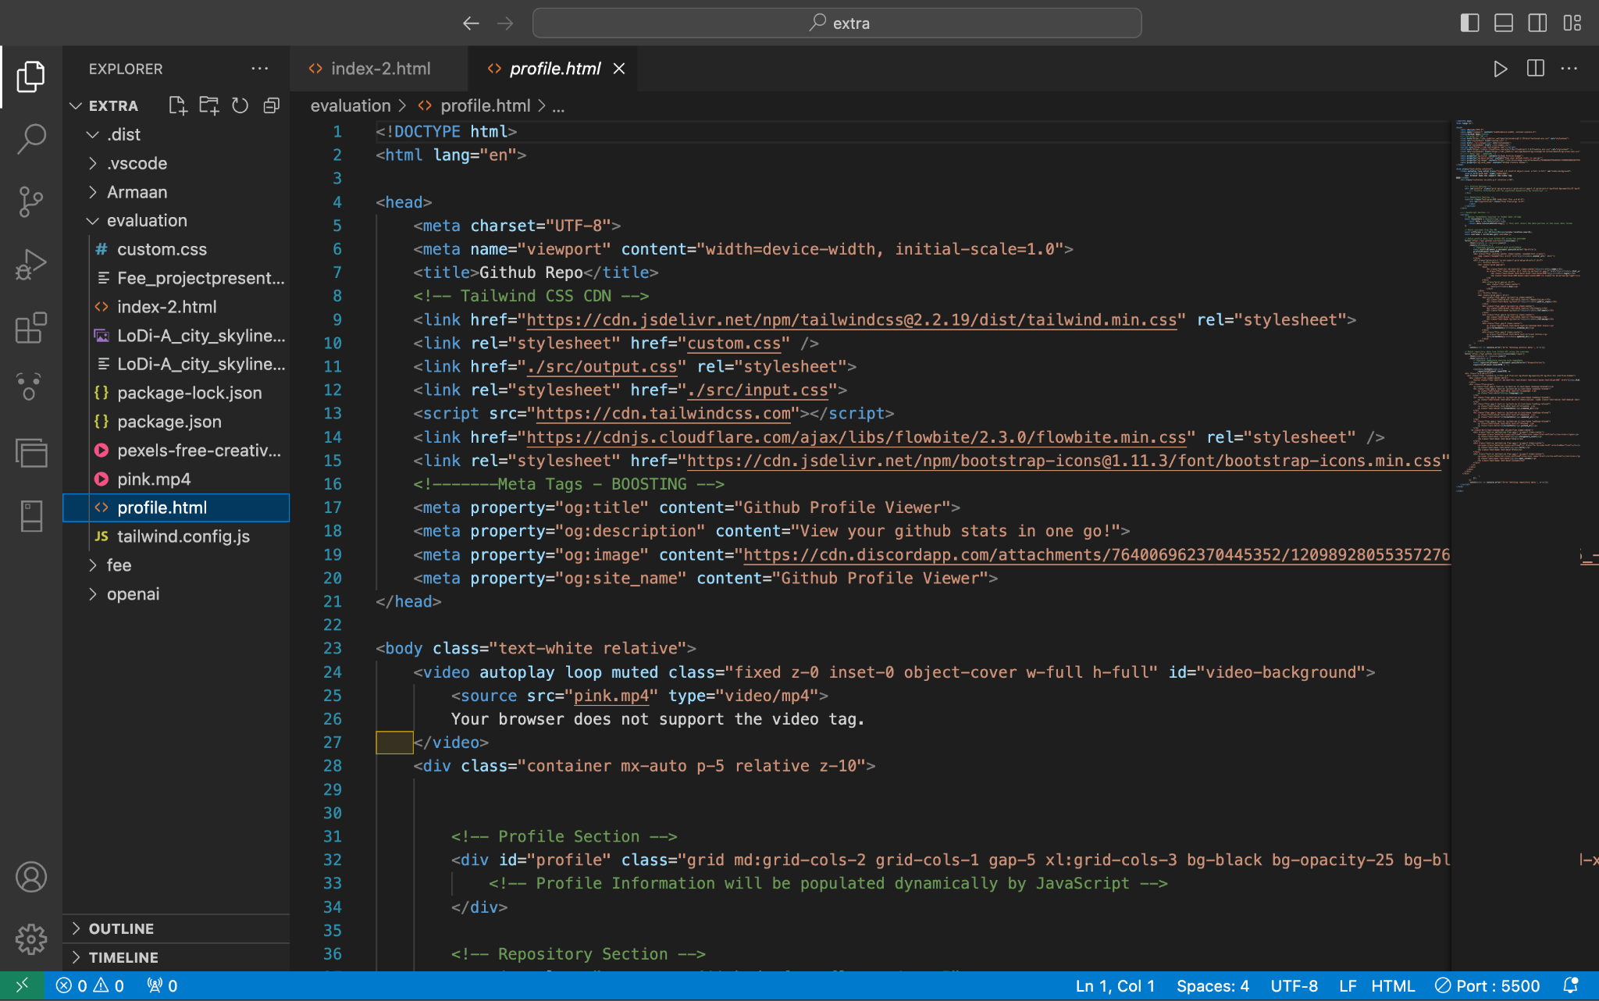
Code Snapshots

Slide 11
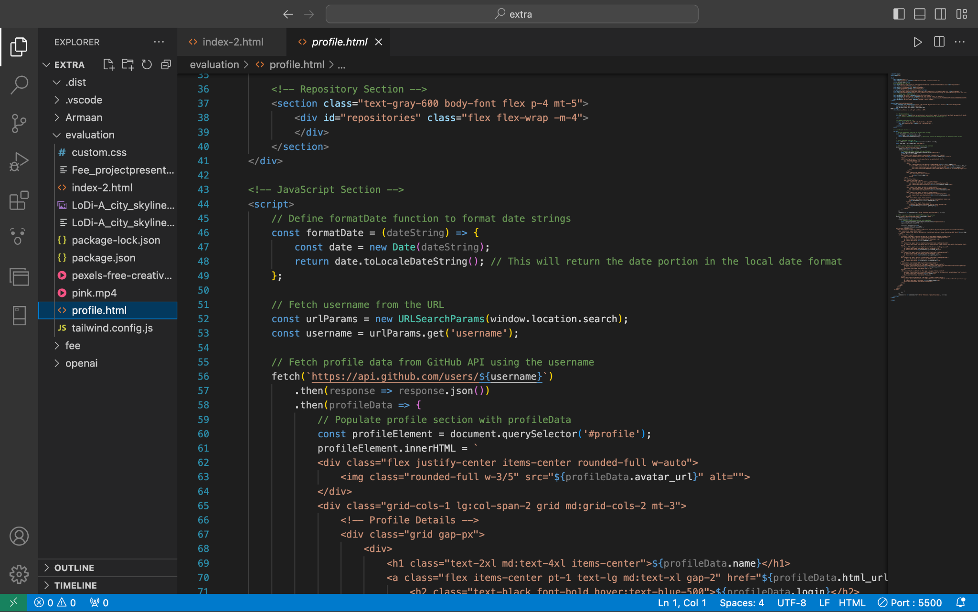
Code Snapshots

Slide 12
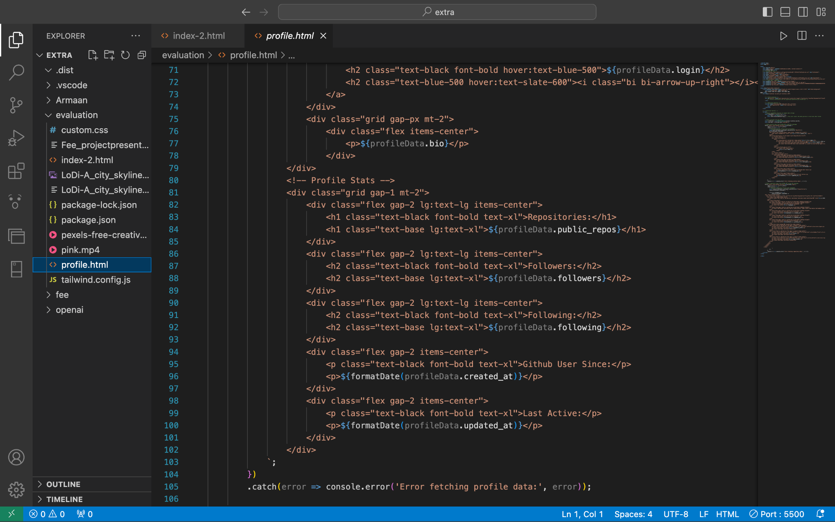
Code Snapshots

Slide 13
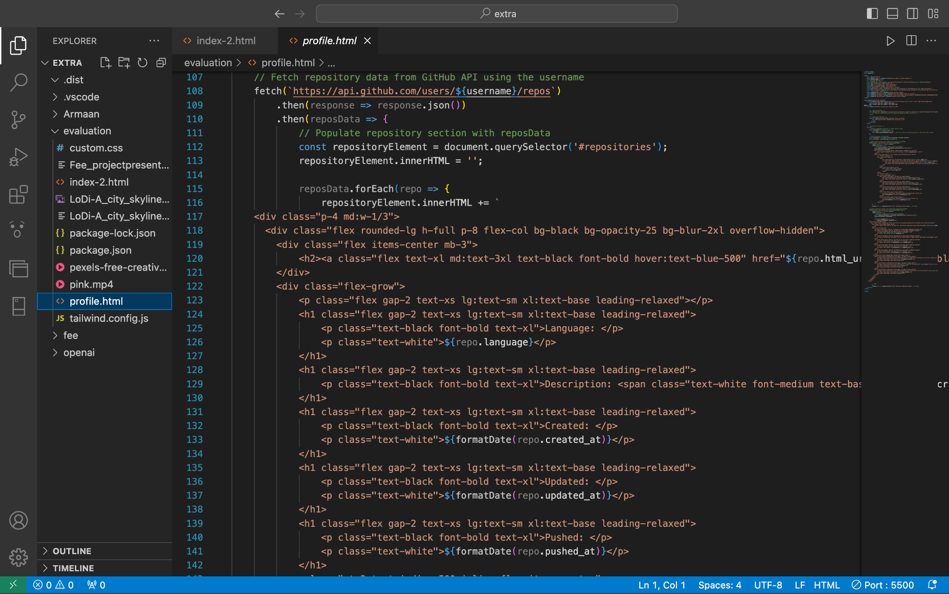
Code Snapshots

Slide 14
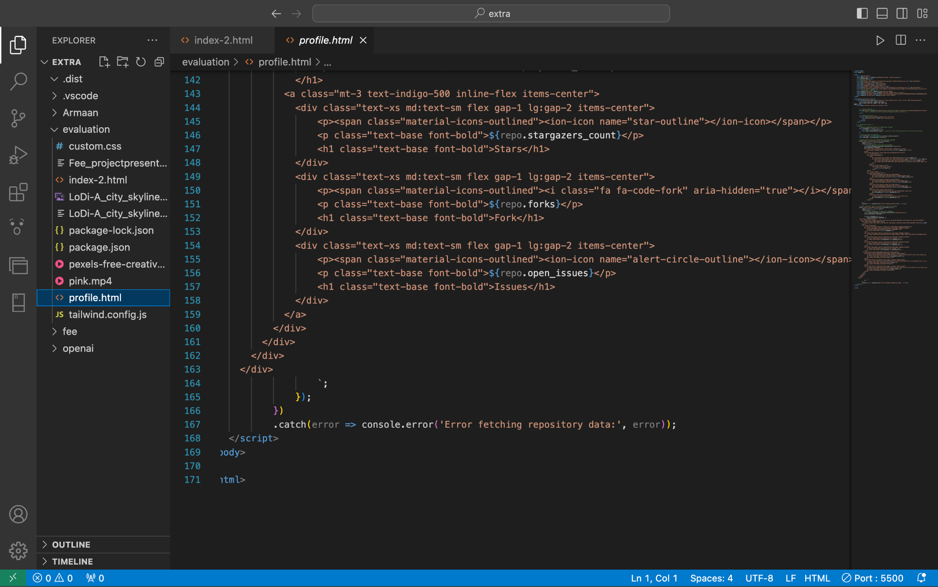
Code Snapshots

Slide 15
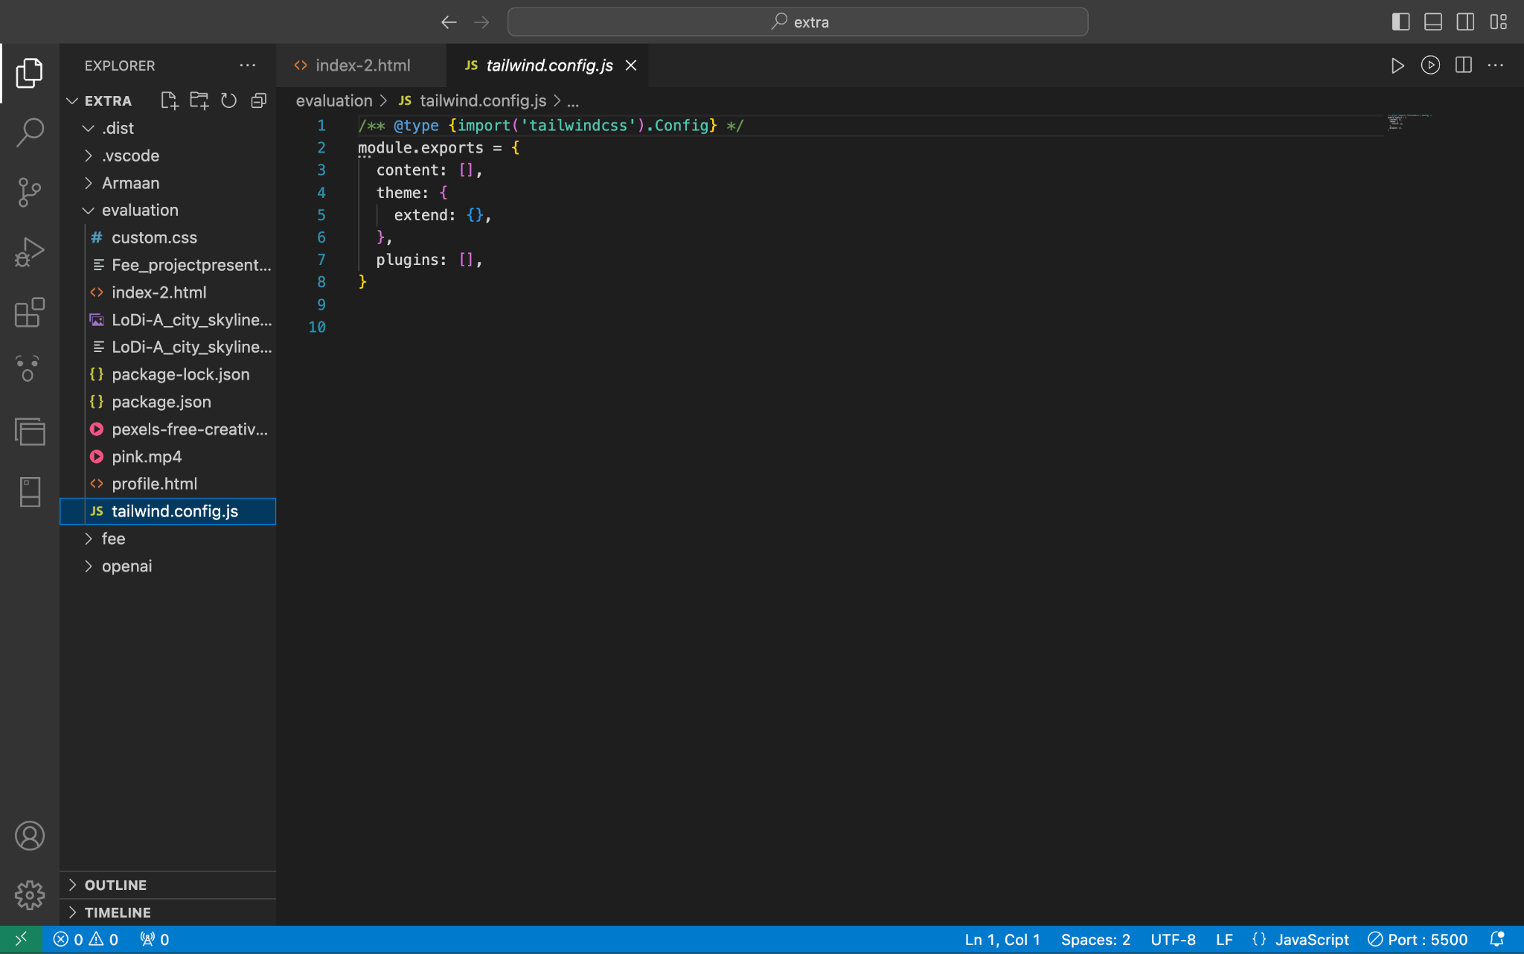
Code Snapshots

Slide 16
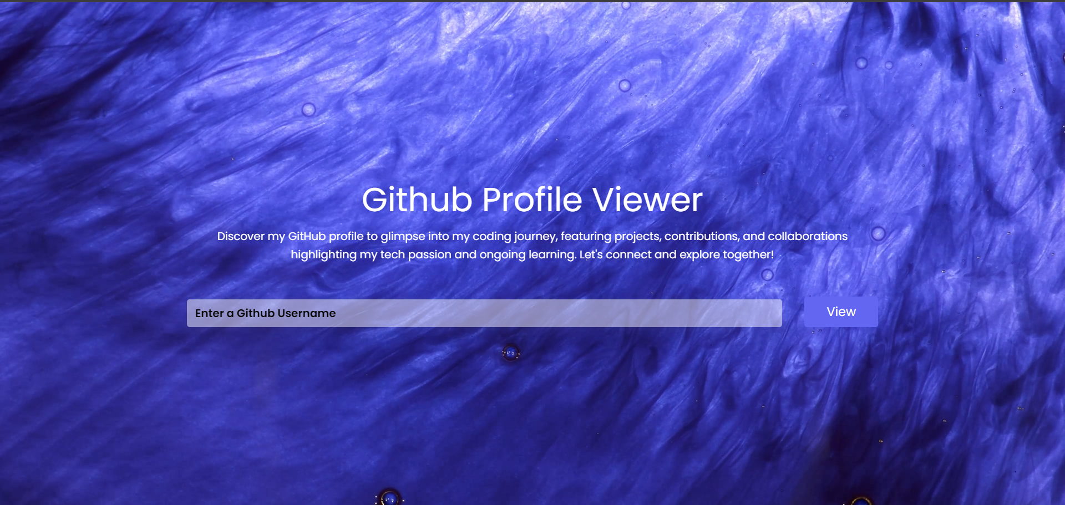
Results

Slide 17
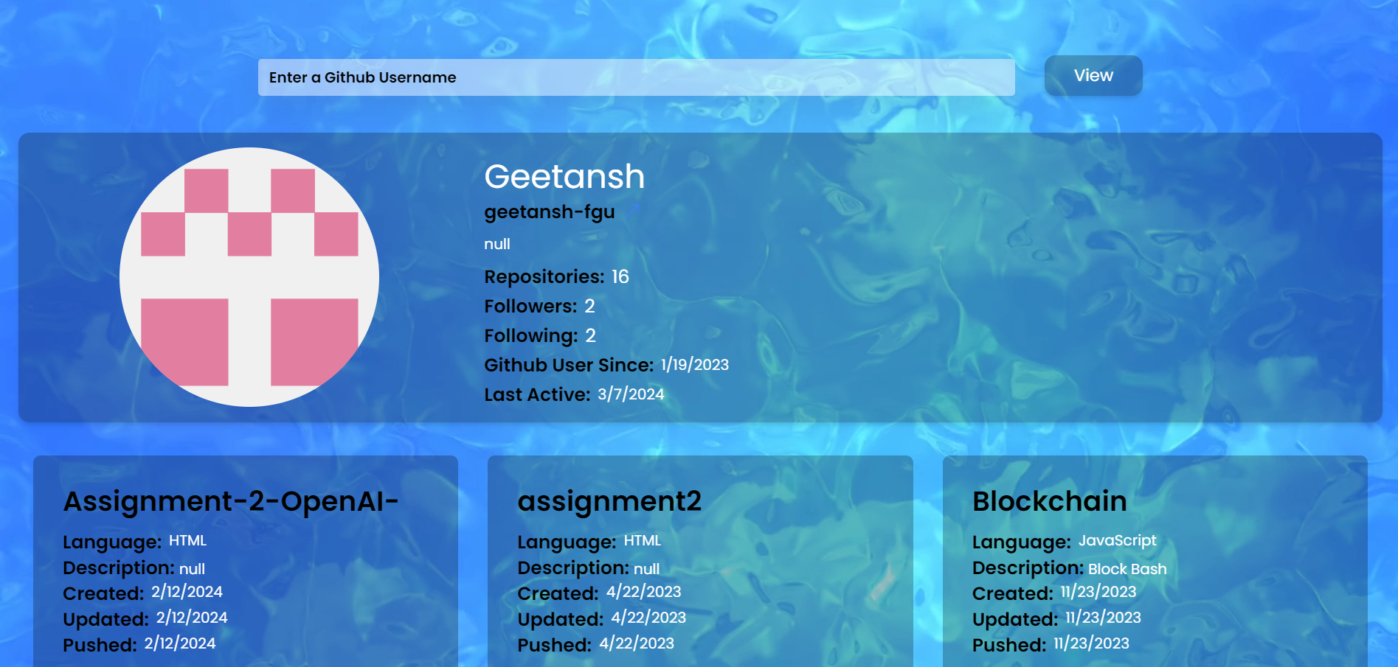
Results

Slide 18
Conclusion
In conclusion, the GitHub Profile Viewer project combines the power of HTML, CSS, JavaScript, and Tailwind to address the challenges developers face in navigating GitHub profiles. The motivation behind this initiative is rooted in the aim to streamline and enhance the user experience, providing a visually appealing and intuitive platform for exploring and understanding a developer's contributions. By leveraging these web technologies, the project aspires to foster a more connected and supportive coding community. The theme plan revolves around creating a seamless interface that not only showcases the technical prowess of developers but also contributes to the overall accessibility and usability of GitHub profiles. Through thoughtful design and interactive elements, the GitHub Profile Viewer seeks to empower users with a comprehensive and engaging tool for exploring the rich tapestry of collaborative coding efforts on GitHub.

Slide 19
References
https://gh-profile-viewer.vercel.app/
https://www.w3schools.com/html/
https://www.w3schools.com/css/default.asp
https://www.w3schools.com/js/default.asp

Slide 20


